Slide 1
Data Mining: Data Exploration
Tom Heskes

Slide 2
What is data exploration?
A preliminary exploration of the data to better understand its characteristics
Key motivations of data exploration include
Helping to select the right tool for preprocessing or analysis
Making use of humans’ abilities to recognize patterns
Related to the area of Exploratory Data Analysis (EDA)
Created by statistician John Tukey
Seminal book is Exploratory Data Analysis by Tukey
A nice online introduction can be found in Chapter 1 of the NIST Engineering Statistics Handbook http://www.itl.nist.gov/div898/handbook/index.htm

Slide 3
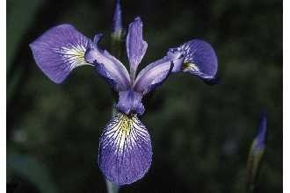
Iris Sample Data Set
Many of the exploratory data techniques are illustrated with the Iris Plant data set
Can be obtained from the UCI Machine Learning Repository http://www.ics.uci.edu/~mlearn/MLRepository.html
From the statistician Douglas Fisher
Three flower types (classes):
Setosa
Virginica
Versicolour
Four (non-class) attributes
Sepal (kelkblad) width and length
Petal (bloemblad) width and length

Slide 4
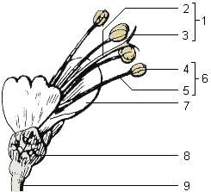
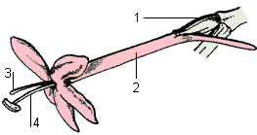
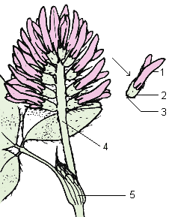
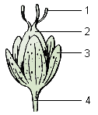
Find the sepal (kelkblad)
rode spoorbloem
basilicum
rode klaver
liggend hertshooi

Slide 5
Summary Statistics
Summary statistics are numbers that summarize properties of the data
Summarized properties include frequency, location and spread
Examples: location - mean spread - standard deviation
Most summary statistics can be calculated in a single pass through the data

Slide 6
Frequency and Mode
The frequency of an attribute value is the percentage of time the value occurs in the data set
For example, given the attribute ‘gender’ and a representative population of people, the gender ‘female’ occurs about 50% of the time
The mode of an attribute is the most frequent attribute value
The notions of frequency and mode are typically used with categorical data

Slide 7
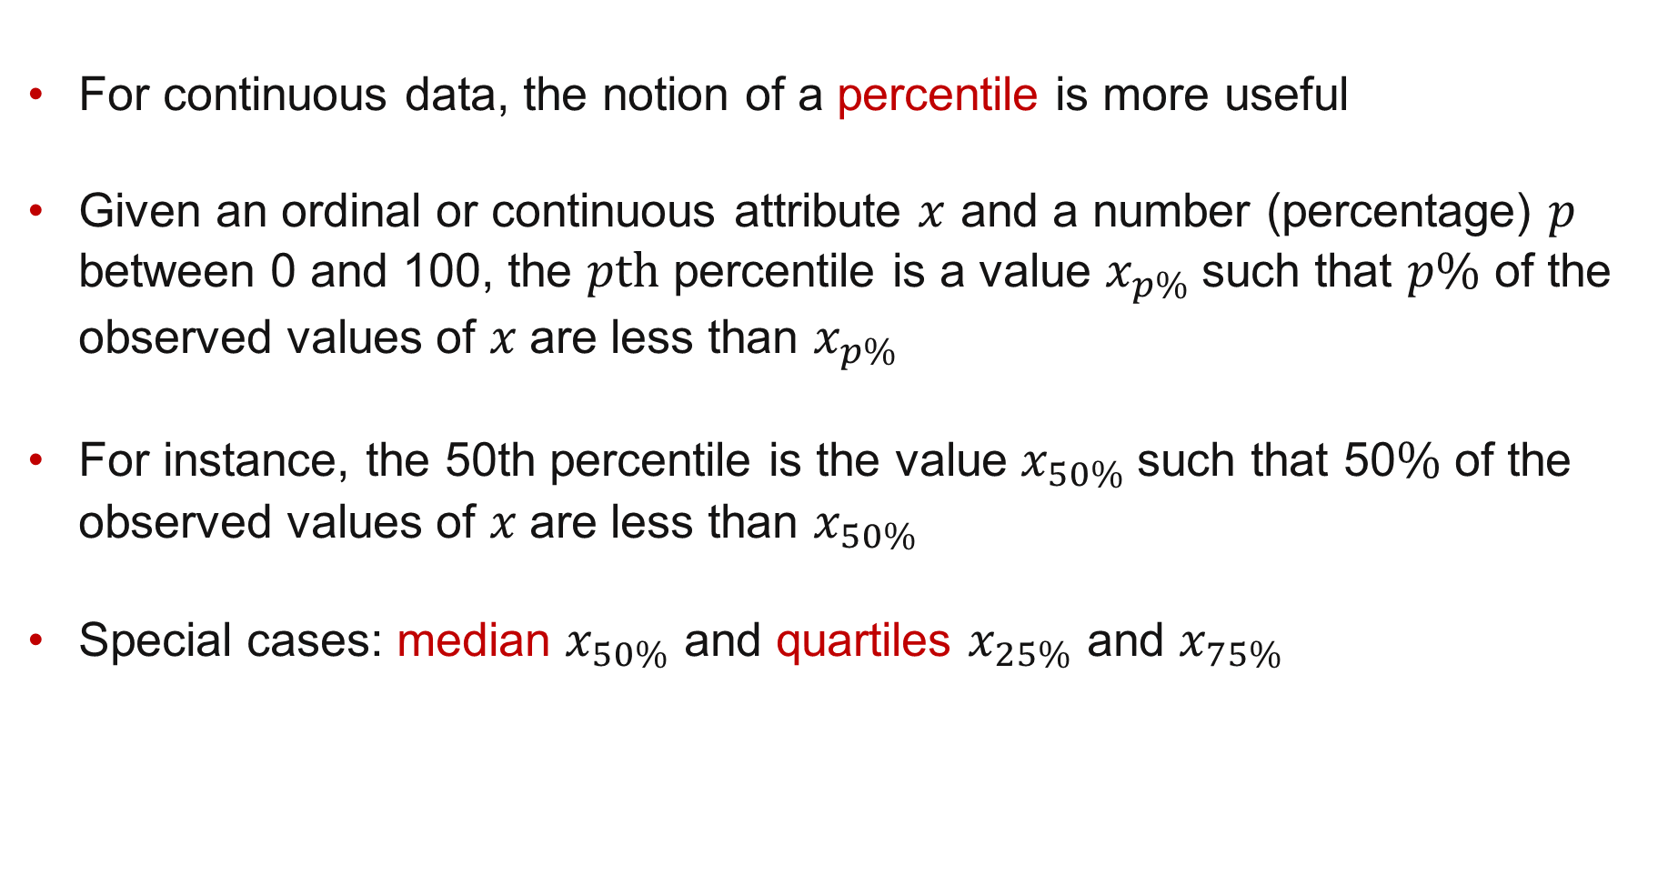
Percentiles
For continuous data, the notion of a percentile is more useful
Given an ordinal or continuous attribute $x$ and a number (percentage) $p$ between 0 and 100, the $p\text{th}$ percentile is a value $x_{p\%}$such that $p\%$ of the observed values of $x$are less than $x_{p\%}$
For instance, the 50th percentile is the value $x_{50\%}$such that 50$\%$ of the observed values of $x$are less than $x_{50\%}$
Special cases: median $x_{50\%}$ and quartiles $x_{25\%}$ and $x_{75\%}$

Slide 8
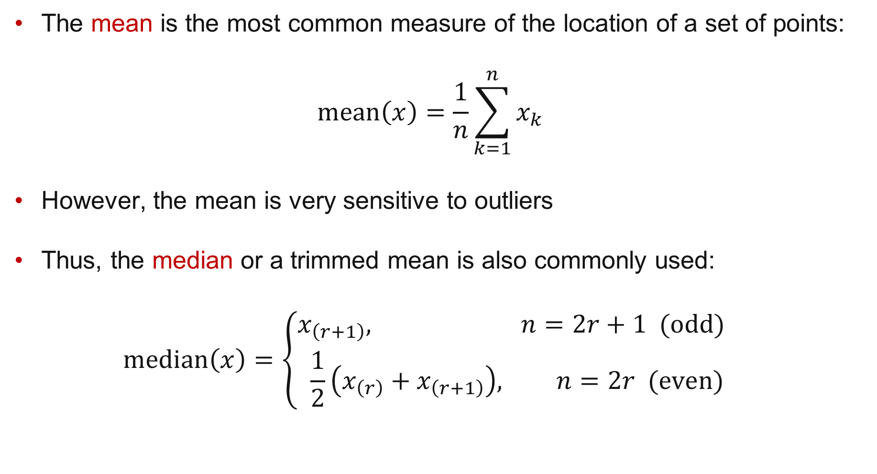
Measures of Location
The mean is the most common measure of the location of a set of points: $\text{mean}\left(x\right)=\frac{1}{n}\sum_{k=1}^{n}{x_{k}}$
However, the mean is very sensitive to outliers
Thus, the median or a trimmed mean is also commonly used: $\text{me}\text{di}\text{an}\left(x\right)=\left\{\begin{aligned}x_{\left(r+1\right)}, n=2r+1\text{ (}\text{odd}\text{)} \\ \frac{1}{2}\left(x_{\left(r\right)}+x_{\left(r+1\right)}\right), n=2r \text{(}\text{even}\text{)}\end{aligned}\right.$

Slide 9
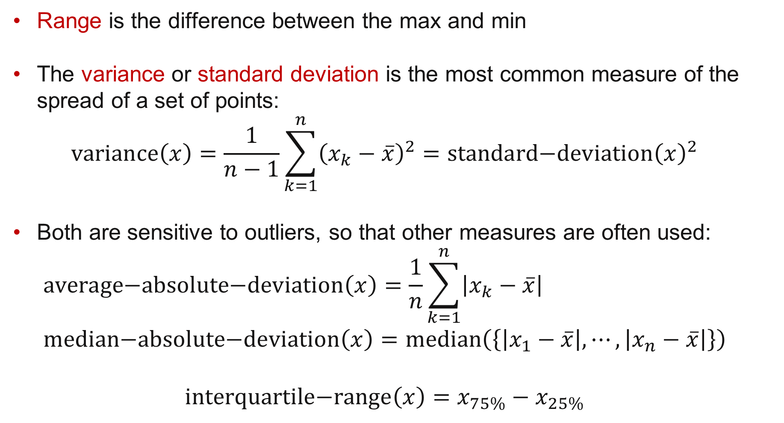
Measures of Spread: Range and Variance
Range is the difference between the max and min
The variance or standard deviation is the most common measure of the spread of a set of points: $\text{varia}\text{n}\text{ce}\left(x\right)=\frac{1}{n−1}\sum_{k=1}^{n}{{\left(x_{k}−\overline{x}\right)}^{2}}=\text{standard}\text{−}\text{deviation}{\left(x\right)}^{2}$
Both are sensitive to outliers, so that other measures are often used: $a\text{verage}\text{−}\text{absolute}\text{−}\text{deviation}\left(x\right)=\frac{1}{n}\sum_{k=1}^{n}{\left|x_{k}−\overline{x}\right|}$ $median\text{−}absolute\text{−}deviation\left(x\right)=\text{median}\left(\left\{\left|x_{1}−\overline{x}\right|,⋯,\left|x_{n}−\overline{x}\right|\right\}\right)$ $\text{interquartile}\text{−}\text{range}\left(x\right)=x_{75\%}−x_{25\%}$

Slide 10
Visualization
Visualization is the conversion of data into a visual or tabular format so that the characteristics of the data and the relationships among data items or attributes can be analyzed or reported.
Visualization of data is one of the most powerful and appealing techniques for data exploration
Humans have a well developed ability to analyze large amounts of information that is presented visually
Can detect general patterns and trends
Can detect outliers and unusual patterns

Slide 11
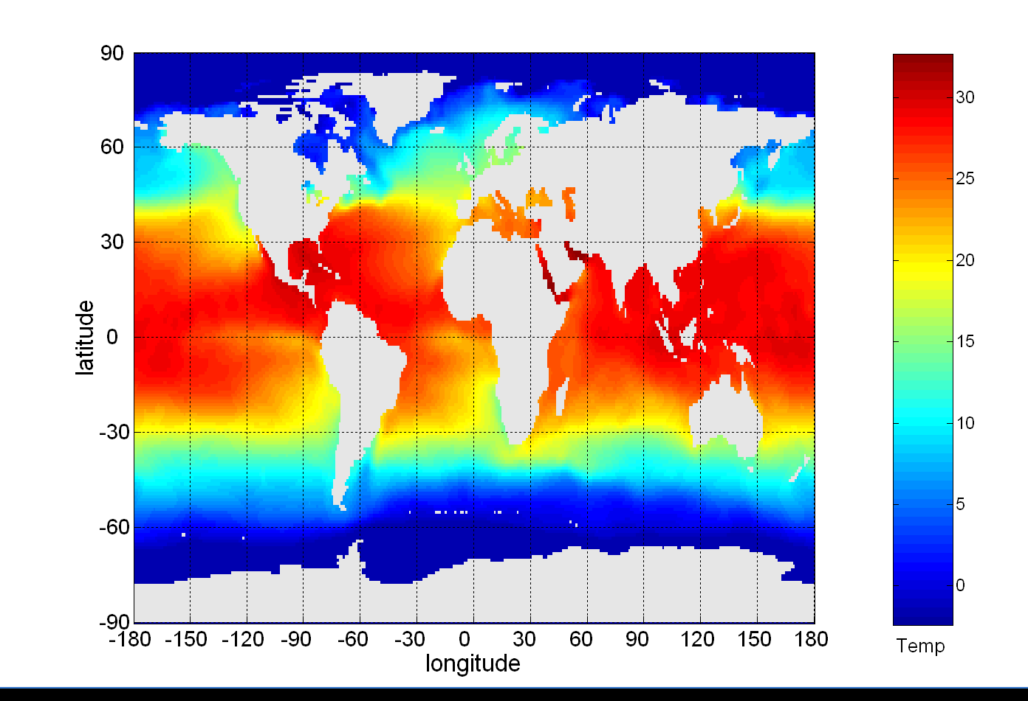
Example: Sea Surface Temperature
The following shows the Sea Surface Temperature (SST) for July 1982
Tens of thousands of data points are summarized in a single figure

Slide 12
Representation
Representation refers to the mapping of information to a visual format
Data objects, their attributes, and the relationships among data objects are translated into graphical elements such as points, lines, shapes, and colors
Example:
Objects are often represented as points
Their attribute values can be represented as the position of the points or the characteristics of the points, e.g., color, size, and shape
If position is used, then the relationships of points, i.e., whether they form groups or a point is an outlier, is easily perceived.

Slide 13
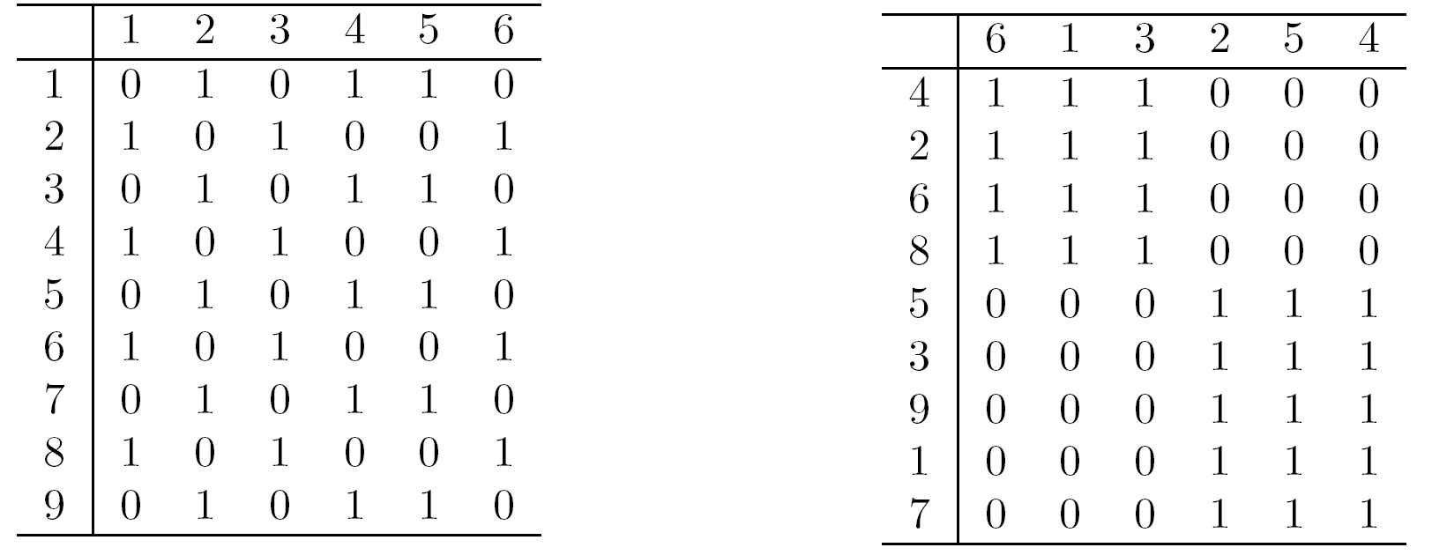
Arrangement
Is the placement of visual elements within a display
Can make a large difference in how easy it is to understand the data

Slide 14
Selection
Selection refers to the elimination or the de-emphasis of certain objects and attributes
Selection may involve choosing a subset of attributes
Dimensionality reduction is often used to reduce the number of dimensions to two or three
Alternatively, pairs of attributes can be considered
Selection may also involve choosing a subset of objects
A region of the screen can only show so many points
Can sample, but want to preserve points in sparse areas

Slide 15
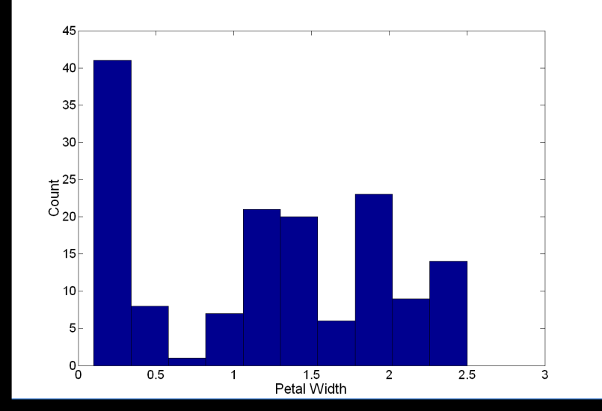
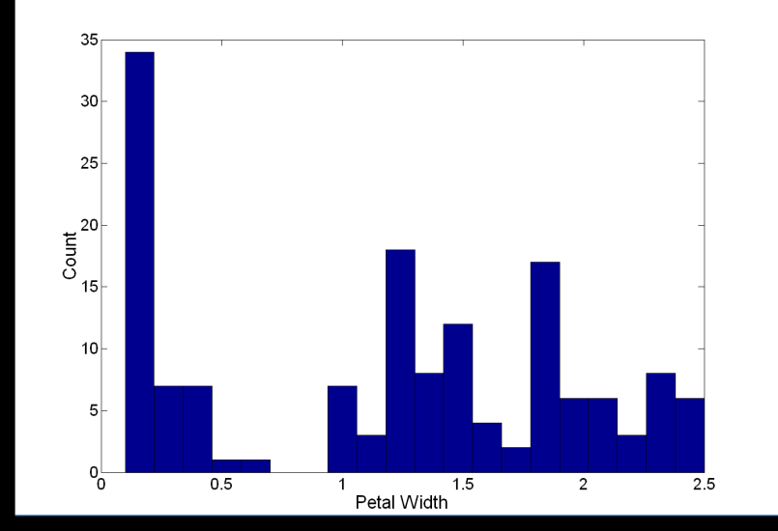
Visualization Techniques: Histograms
Histogram
Usually shows the distribution of values of a single variable
Divide the values into bins and show a bar plot of the number of objects in each bin.
The height of each bar indicates the number of objects
Shape of histogram depends on the number of bins
Example: Petal Width (10 and 20 bins, respectively)

Slide 16
MATLAB Code for Histogram
% Load iris data set
load fisheriris % meas (measurements), species (classes)
% Plot histograms
subplot(221)
hist(meas(:,4),10)
xlabel('Petal Width'), ylabel('Count')
title('Ten Bins')
subplot(222)
hist(meas(:,4),20)
xlabel('Petal Width'), ylabel('Count')
title('Twenty Bins')

Slide 17
Python Code for Histogram
# Load iris data set
f = loadmat("fisheriris.mat") % meas, species
meas = f['meas']
species = f['species']
# Plot histogram
plt.subplot(2, 2, 1)
plt.hist(meas[:,3], bins=10)
plt.xlabel('Petal Width')
plt.ylabel('Count')
plt.title('10 bins')

Slide 18
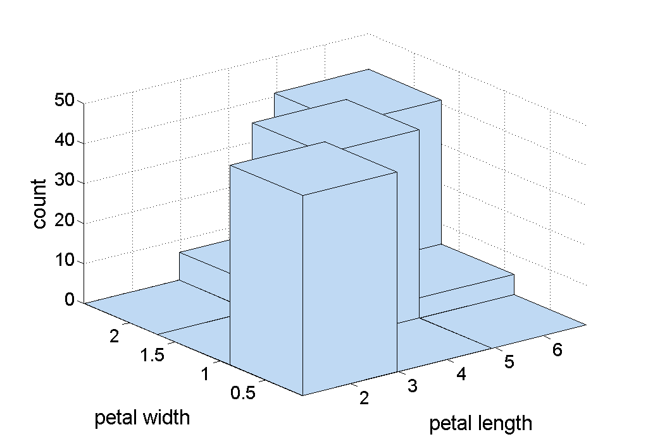
Two-Dimensional Histograms
Show the joint distribution of the values of two attributes
Example: petal width and petal length
Code: hist3(meas(:,3:4),[3,3]) xlabel('petal length') ylabel('petal width') zlabel('count')

Slide 19
Visualization Techniques: Box Plots
Invented by J. Tukey
Another way of displaying the distribution of data
outlier
largest value within 1.5x interquartile range
75th percentile
50th percentile
25th percentile
smallest value within 1.5x interquartile range

Slide 20
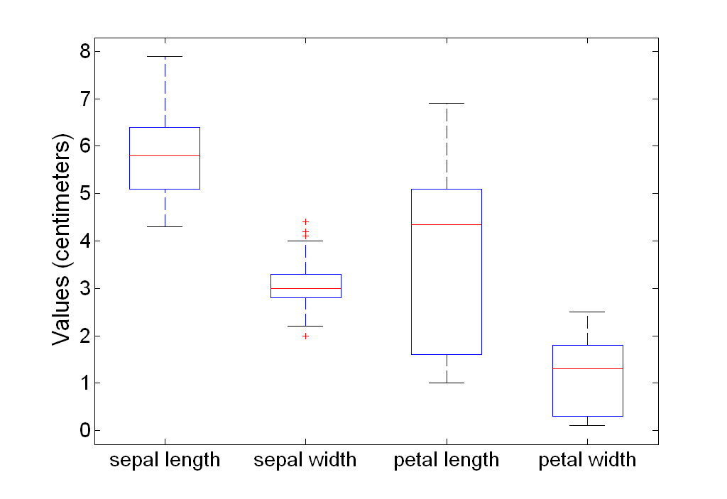
Example of Box Plots
varnames = ...
{'sepal length','sepal width','petal length','petal width'};
boxplot(meas,varnames) ylabel('Values (centimeters)')

Slide 21
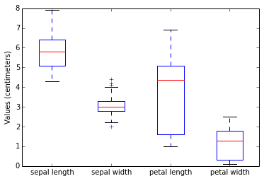
Box Plots in Python
plt.boxplot(meas)
plt.ylabel('Values (centimeters)')
plt.xticks([1, 2, 3, 4],
['sepal length','sepal width',
'petal length','petal width'])

Slide 22
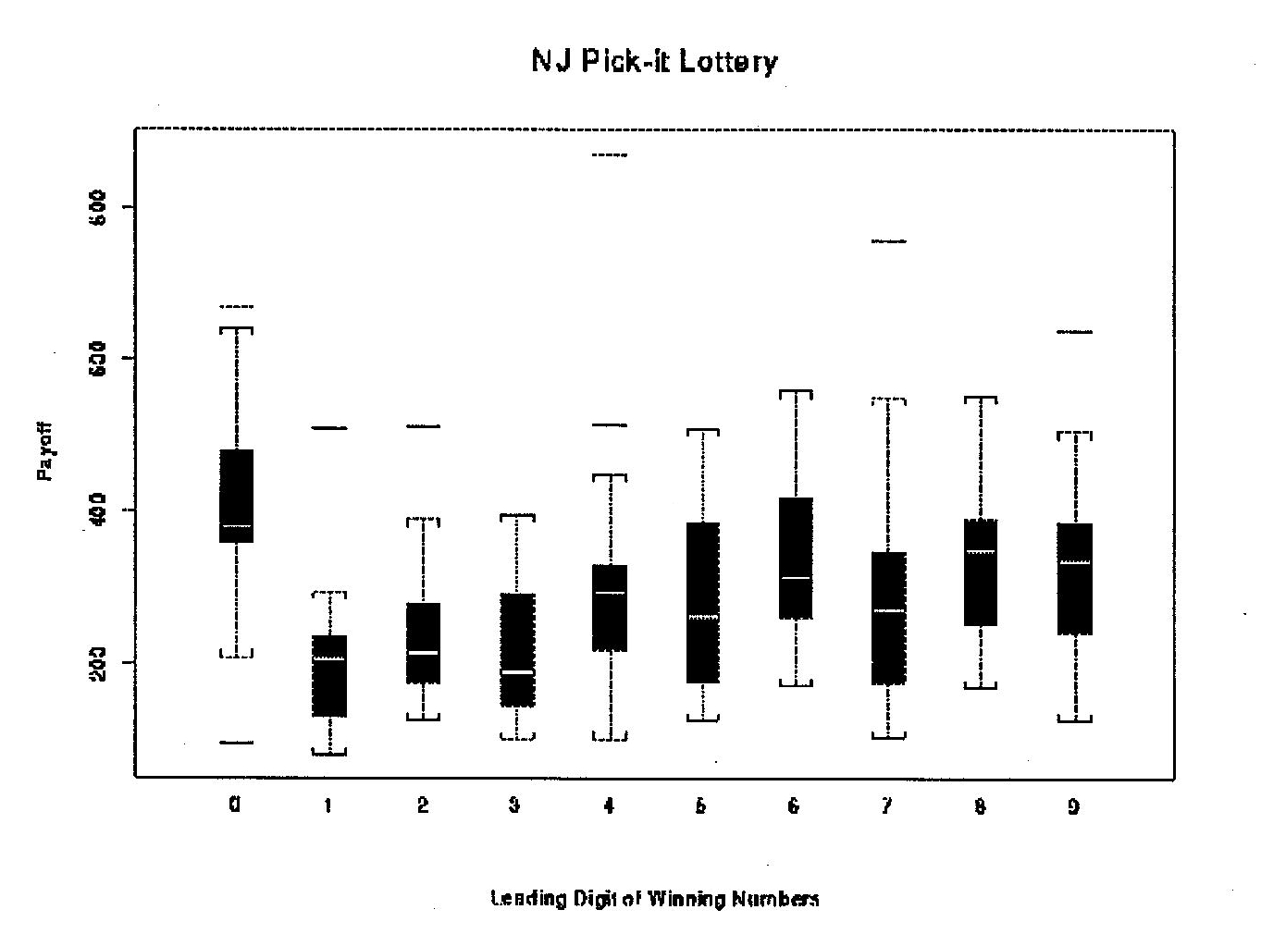
Boxplot of Lottery Pay-off

Slide 23
Visualization Techniques: Scatter Plots
Attributes values determine the position
Two-dimensional scatter plots most common, but can have three-dimensional scatter plots
Often additional attributes can be displayed by using the size, shape, and color of the markers that represent the objects
Arrays of scatter plots can compactly summarize the relationships of several pairs of attributes

Slide 24
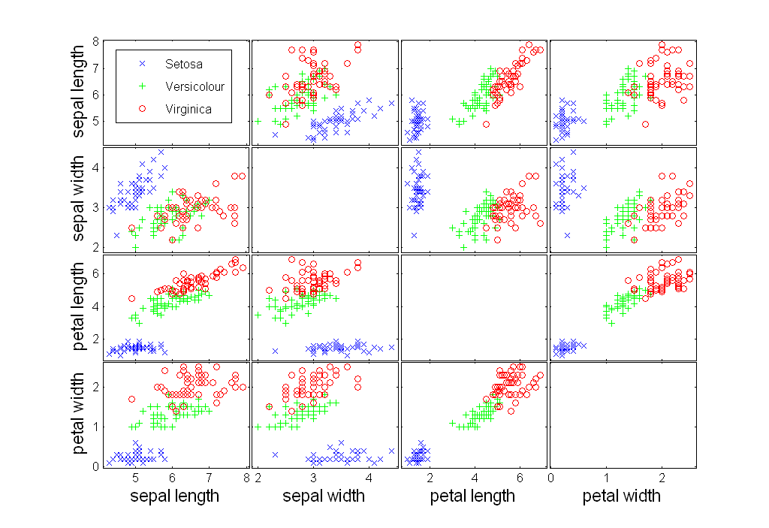
Scatter Plot Array of Iris Attributes
gplotmatrix(meas,[],species,... [],'x*o',[],'on','none',varnames)

Slide 25
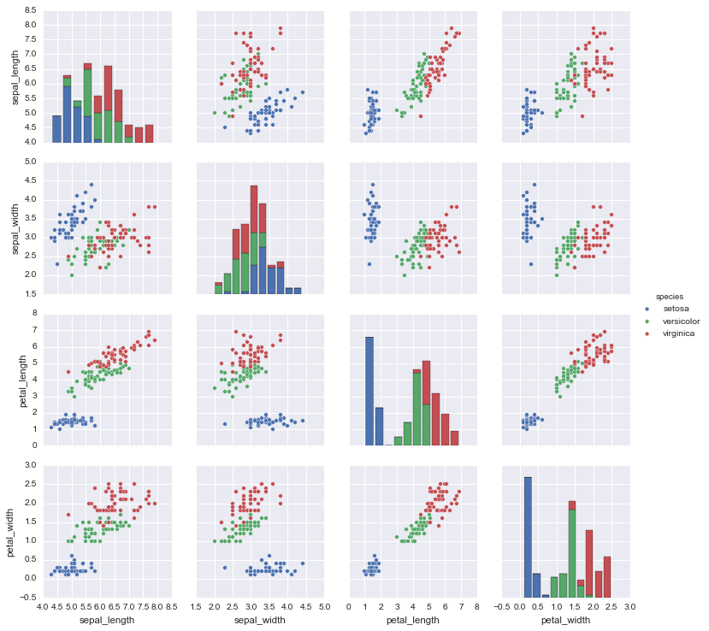
Python: use pandas or seaborn

Slide 26
Visualization Techniques: Contour Plots
Useful when a continuous attribute is measured on a spatial grid
They partition the plane into regions of similar values
The contour lines that form the boundaries of these regions connect points with equal values
The most common example is contour maps of elevation
Can also display temperature, rainfall, air pressure, etc.

Slide 27
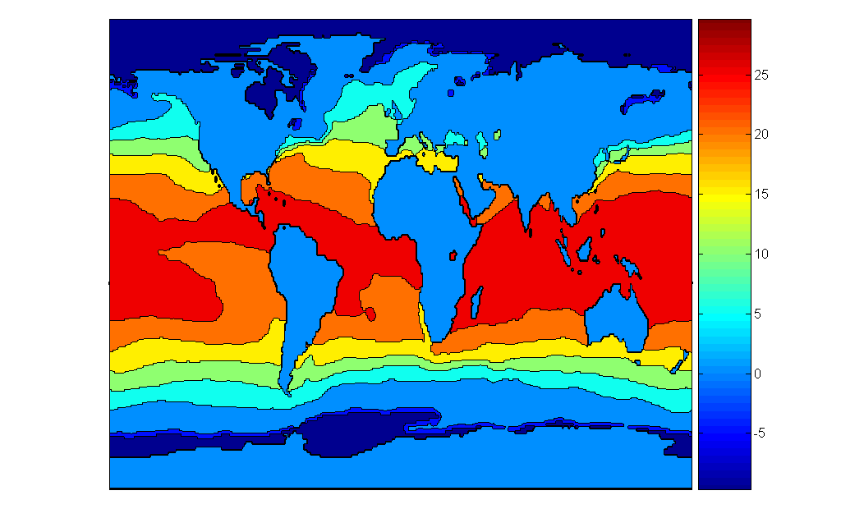
Contour Plot Example: SST Dec, 1998
Celsius

Slide 28
Visualization Techniques: Matrix Plots
Can plot the data matrix
This can be useful when objects are sorted according to class
Typically, the attributes are normalized to prevent one attribute from dominating the plot
Plots of similarity or distance matrices can also be useful for visualizing the relationships between objects

Slide 29
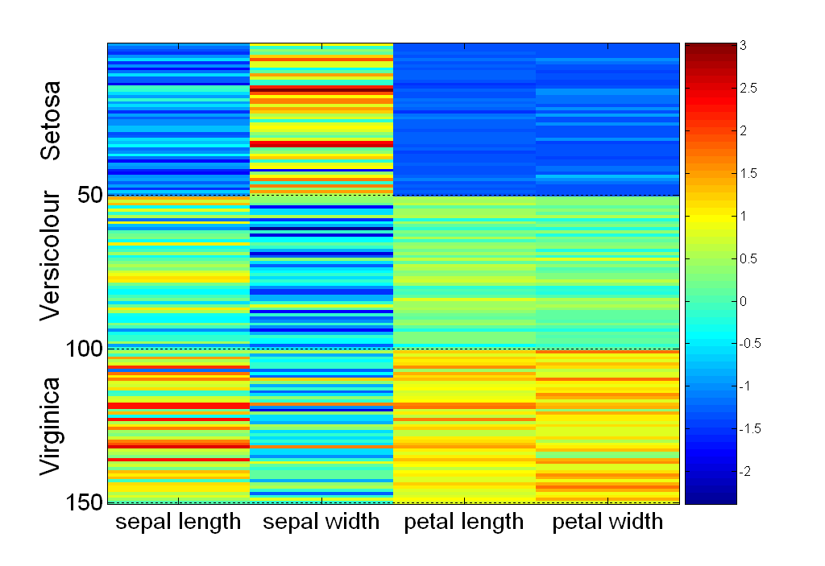
Visualization of the Iris Data Matrix
standard
deviation

Slide 30
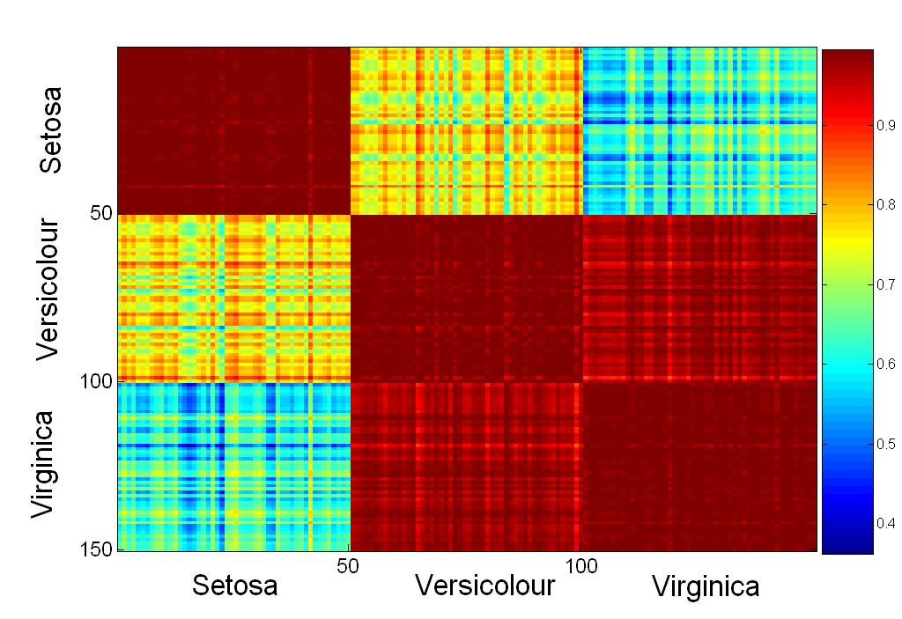
Visualization of the Iris Correlation Matrix

Slide 31
Visualization Techniques: Parallel Coordinates
Used to plot the attribute values of high-dimensional data
Instead of using perpendicular axes, use a set of parallel axes
The attribute values of each object are plotted as a point on each corresponding coordinate axis and the points are connected by a line
Thus, each object is represented as a line
Often, the lines representing a distinct class of objects group together, at least for some attributes
Ordering of attributes is important in seeing such groupings

Slide 32
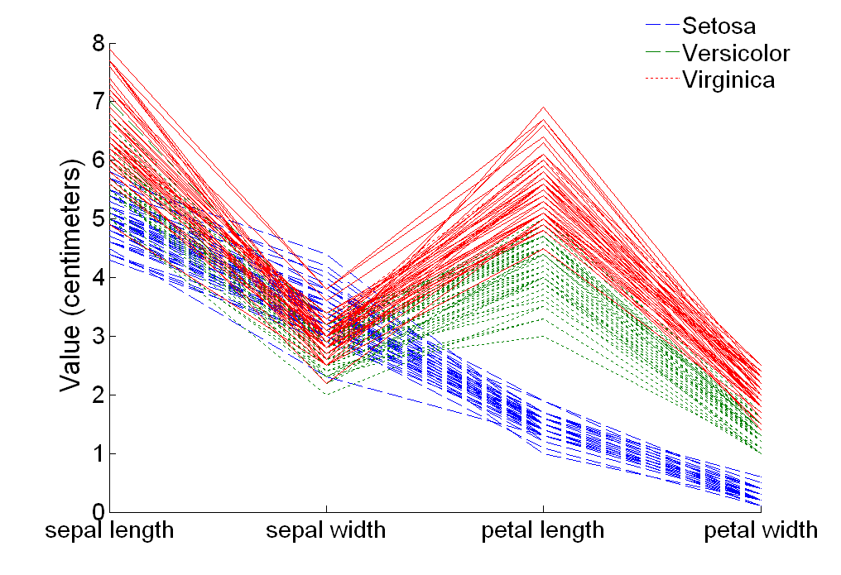
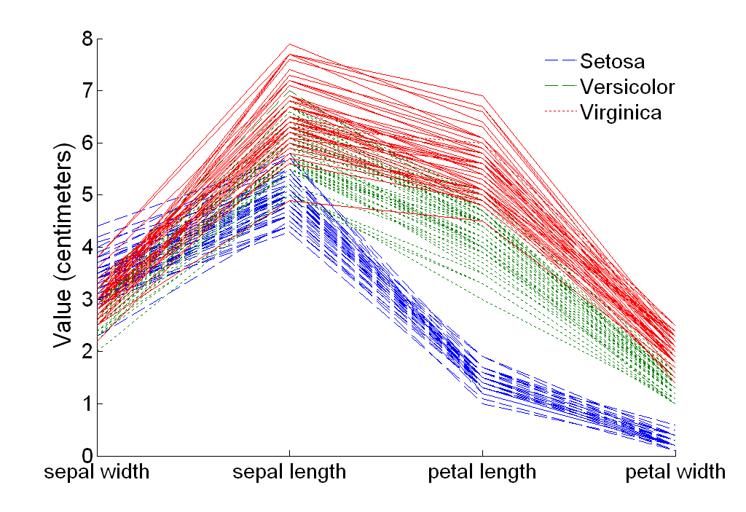
Parallel Coordinates Plots for Iris Data
parallelcoords(meas,'group',species,'labels',varnames)
parallelcoords(meas(:,[2,1,3,4]),'group',species,...
'labels',varnames([2,1,3,4]))
ylabel('Values (centimeters)')

Slide 33
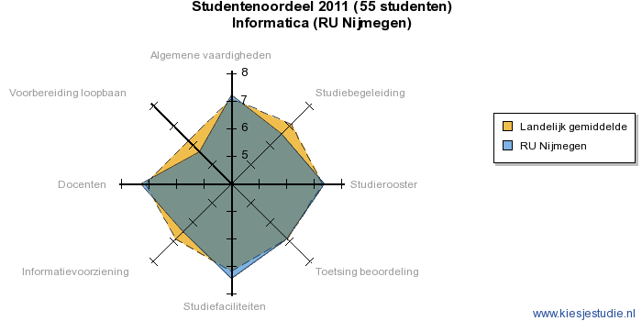
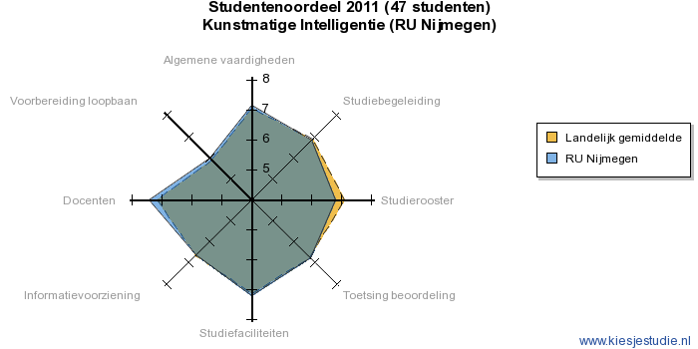
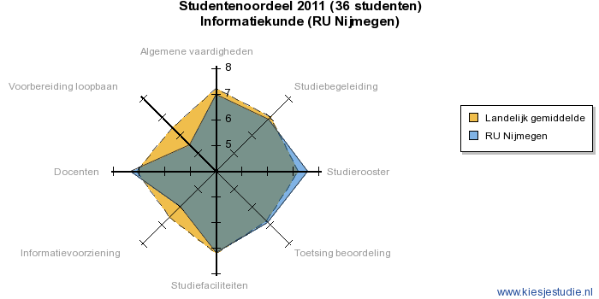
Star Plots
Similar approach to parallel coordinates, but axes radiate from a central point
The line connecting the values of an object is a polygon

Slide 34
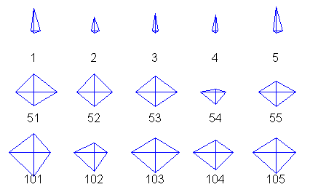
Star Plots for Iris Data
glyphplot(meas(indices,:),'ObsLabels',labels)
Setosa
Versicolour
Virginica

Slide 35
MATLAB Code for Star Plot
% Choose indices and create labels
indices = [1:5,51:55,101:105];
labels = cell(1,15);
for i=1:15,
labels{i} = num2str(indices(i));
end
% Make star plots
glyphplot(meas(indices,:),'ObsLabels',labels)

Slide 36
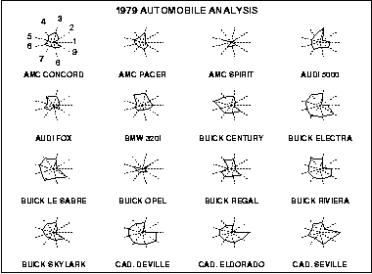
Star Plots for Cars
Price
Mileage (MPG)
1978 Repair Record (1 = Worst, 5 = Best)
1977 Repair Record (1 = Worst, 5 = Best)
Headroom
Rear Seat Room
Trunk Space
Weight
Length

Slide 37
Chernoff Faces
Approach created by Herman Chernoff
This approach associates each attribute with a characteristic of a face
The values of each attribute determine the appearance of the corresponding facial characteristic
Each object becomes a separate face
Relies on human’s ability to distinguish faces

Slide 38
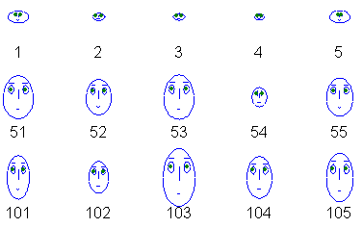
Chernoff Faces for Iris Data
glyphplot(meas(indices,:),'ObsLabels',labels,'Glyph','face')
Setosa
Versicolour
Virginica

Slide 39
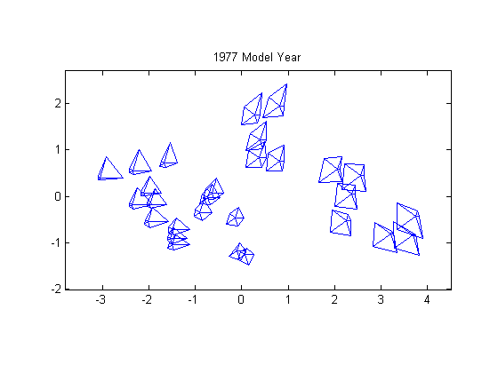
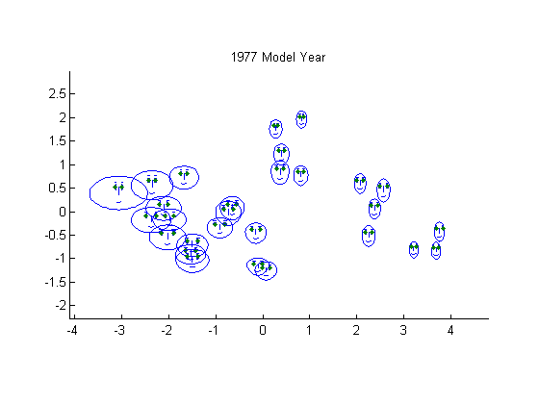
Clustering Combinations

Slide 40
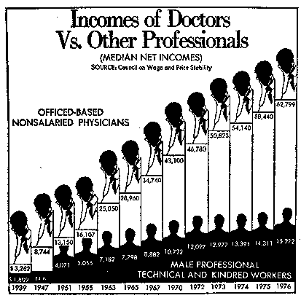
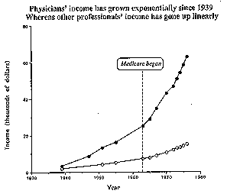
Cheating
Graph showing change in income of doctors vs. other professionals
Appears to indicate a more or less linear increase in both
Cheating: axes are unevenly spaced!
Correct spacing reveals exponential increase

Slide 41
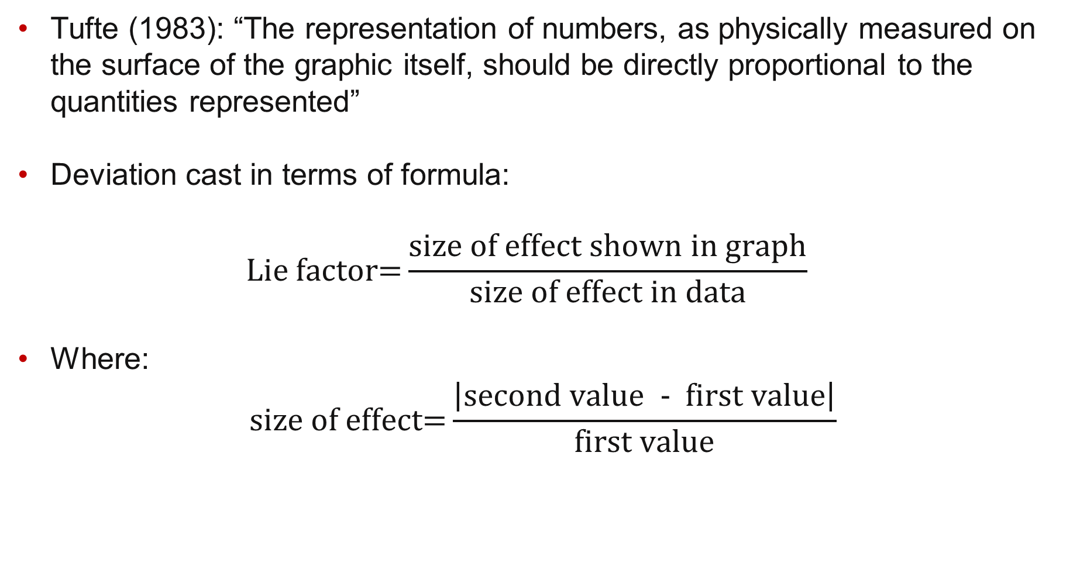
Lie factor
Tufte (1983): “The representation of numbers, as physically measured on the surface of the graphic itself, should be directly proportional to the quantities represented”
Deviation cast in terms of formula: $\text{Lie} \text{factor}\text{=}\frac{\text{size} \text{of} \text{effect} \text{shown} \text{in} \text{graph}}{\text{size} \text{of} \text{effect} \text{in} \text{data}}$
Where: $\text{size} \text{of} \text{effect}\text{=}\frac{\left|\text{second} \text{value}\text{ − }\text{first} \text{value}\right|}{\text{first} \text{value}}$

Slide 42
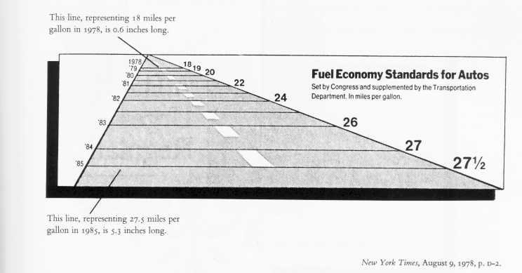
The Lie Factor (1)
Mandated fuel economy standards set by the US Department of Transportation
The standard required an 53% increase in mileage from 18 to 27.5
The magnitude of increase shown in the graph is 783%
Lie factor = (783/53) = 14.8!

Slide 43
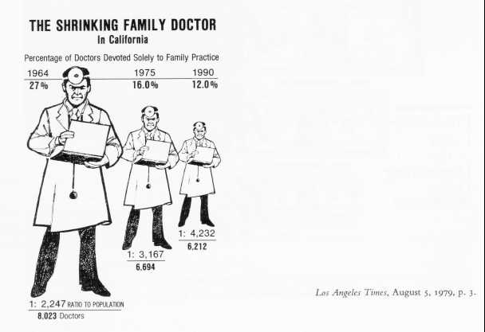
The Lie Factor (2)
Changes in the scale of the graphic should always correspond to changes in the data being represented
This graph violates that principle by using area to show one-dimensional data
Lie factor: 2.8

Slide 44
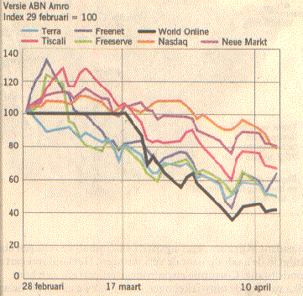
World On Line (1)
Stock prices of the Dutch internet provider World On Line (WOL) halved within less than two weeks after entering the Amsterdam Stock Exchange
ABN AMRO: “We could not foresee this. Many other funds were in a downfall too; some of them more than WOL”
The bank illustrated this by the graph on the right.

Slide 45
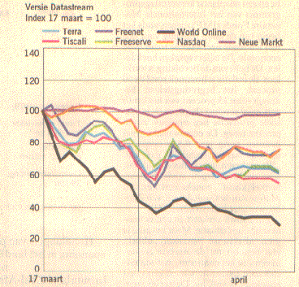
World On Line (2)
No reason for a flat line between February 28 and March 17, the start WOL’s stock market quotation.
Unshifting the base date for the index numbers to March 17 give this graph, in which WOL appears to be very quickly heading down the toilet…

Slide 46
ACCENT
Apprehension
Is it easy to see what is important in the graph?
Clarity
Are the most important elements visually most prominent?
Consistency
Have you used the same colors, shapes, etc. as in other graphs?
Efficiency
Does it convey its information in the most simple and efficient way?
Necessity
Are all elements of the graph necessary to represent data?
Truthfulness
Does the graph represent the data correctly?

Slide 47
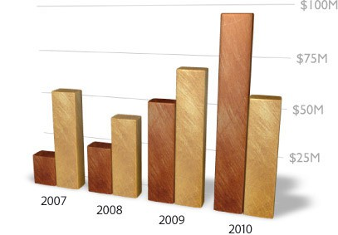
Apple vs Microsoft

Slide 48
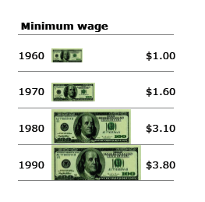
Minimum wage

Slide 49
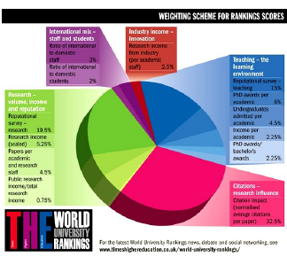
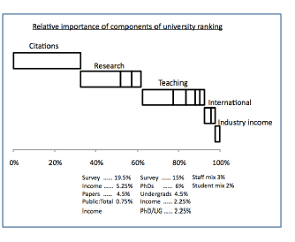
University Rankings

Slide 50
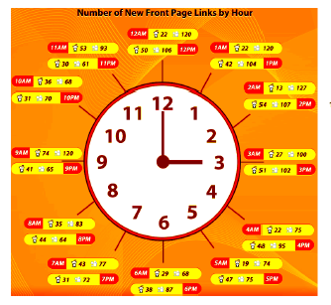
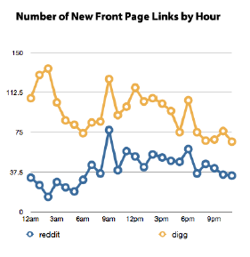
New Links

Slide 51
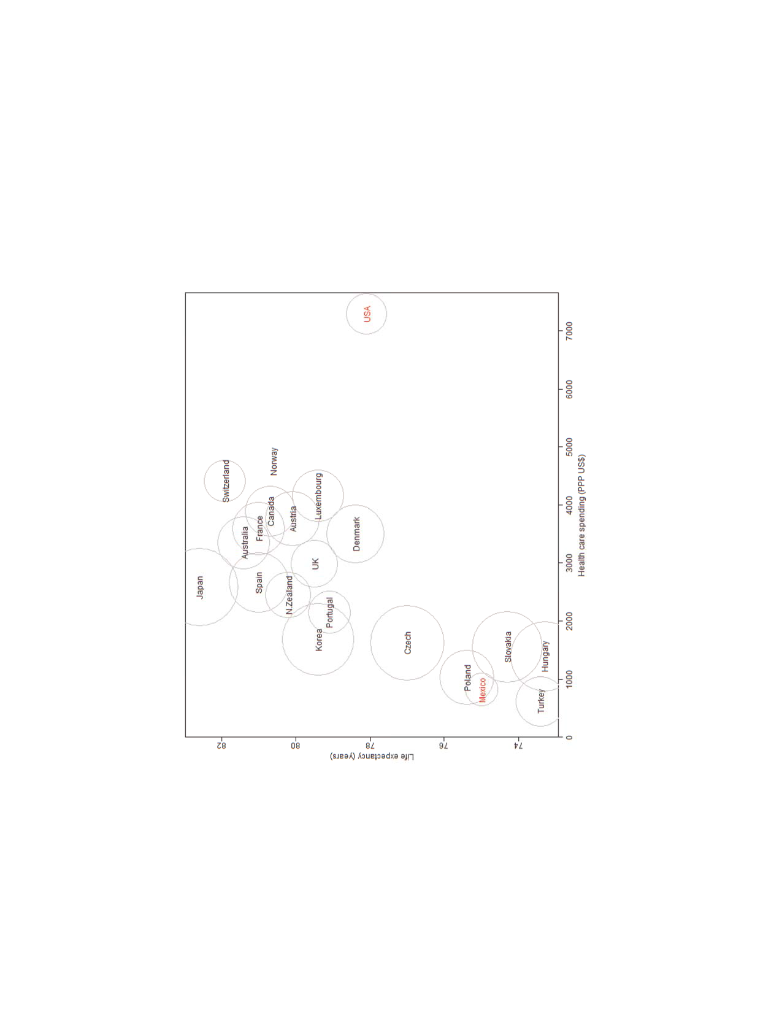
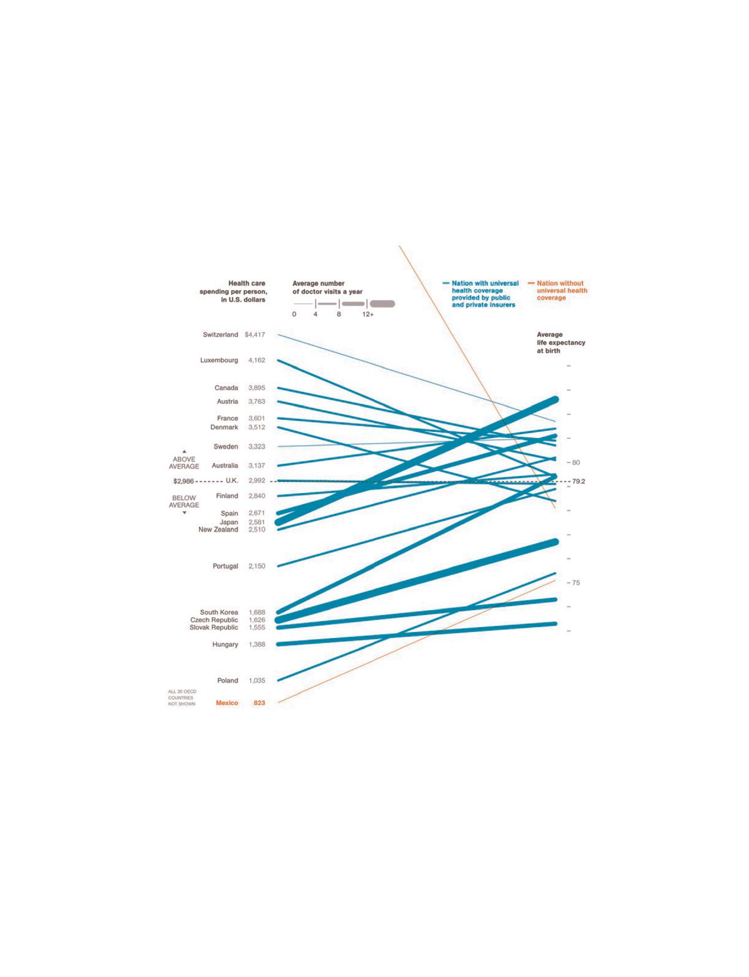
Life Expectancy

Slide 52
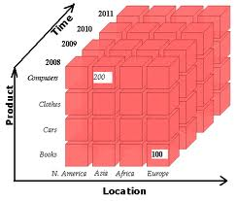
OLAP
On-Line Analytical Processing (OLAP) was proposed by E. F. Codd, the father of the relational database
Relational databases put data into tables, while OLAP uses a multidimensional array representation.
Such representations of data previously existed in statistics and other fields
There are a number of data analysis and data exploration operations that are easier with such a data representation:
dicing
slicing
drill down
roll up

Slide 53
Handling Big Data
Data everywhere
Global data volume grows exponentially
Need means of economically storing and processing large data sets
Opportunity
Commodity hardware is ultra cheap
CPU and storage even cheaper
Traditional solution
Store data in a (relational) database
Run batch jobs for processing
Problems with existing solutions
Databases are seek heavy; seeks are wasted time
Databases do not play well with commoditized hardware
Databases were not built with horizontal scaling in mind
Slides acknowledgment: Friso van Vollenhoven, Xebia

Slide 54
Parallel Processing
Eliminate the seeks, only sequential reading / writing
Work with batches for efficiency
Parallelize work load
Distribute processing and storage

Slide 55

MapReduce and Hadoop
2000: Apache Lucene: batch index updates and sort/merge with on disk index
2002: Apache Nutch: distributed, scalable open source web crawler; sort/merge optimization applies
2004: Google publishes Google File System (GFS) and MapReduce (MR) papers
2006: Apache Hadoop: open source Java implementation of GFS and MR to solve Nutch’ problem; later becomes standalone project

Slide 56
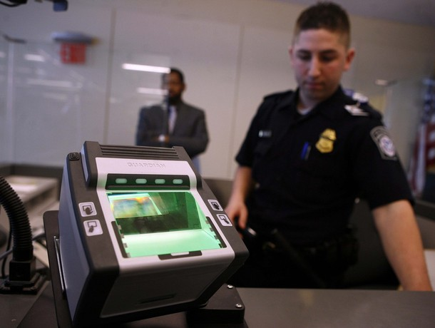
Hadoop Example (1)
US government builds their finger print search index using Hadoop

Slide 57
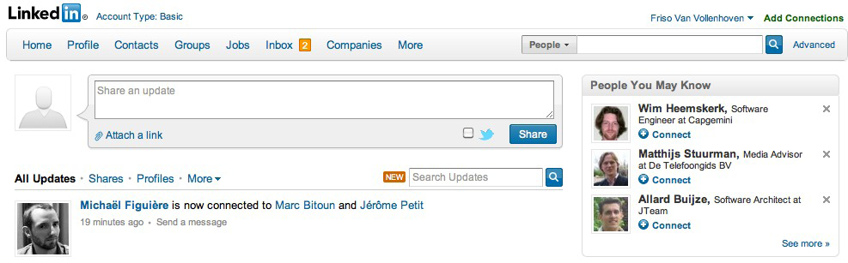
Hadoop Example (2)
The contents for the People You May Know feature is created by a chain of many MapReduce jobs that run daily. The jobs are reportedly a combination of graph traversal, clustering and machine learning

Slide 58
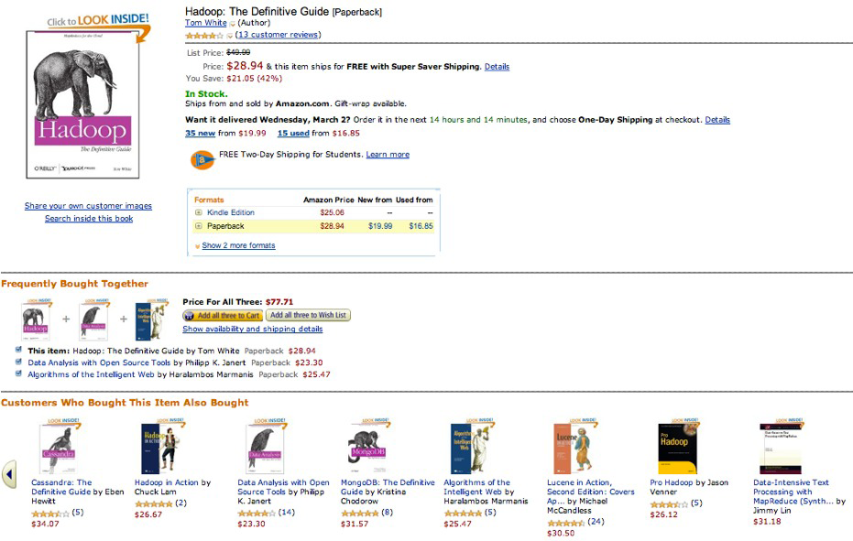
Hadoop Example (3)
Amazon’s Frequently Bought Together and Customers Who Bought This Item Also Bought features are brought to you by MapReduce jobs.

Slide 59

Hadoop Example (4)
Top Charts generated daily based on millions of users’ listening behavior.

Slide 60

Hadoop Example (5)
Top searches used for auto-completion are re-generated daily by a MapReduce job using all searches for the past couple of days. Popularity for search terms can be based on counts, but also trending and correlation with other datasets (e.g. trending on social media, news, charts in case of music and movies, best seller lists, etc.)

Slide 61
Hadoop File System (1)
Distributed file system
Consists of a single master node and multiple (many) data nodes
Files are split up in blocks (typically 64MB)
Blocks are spread across data nodes in the cluster
Each block is replicated multiple times to different data nodes in the cluster (typically 3 times)
Master node keeps track of which blocks belong to a file

Slide 62

Hadoop File System (2)

Slide 63

MapReduce
Input data
Required output

Slide 64

Map Step
Map: extract something useful from each record
void map(recordNumber, record) {
key = record.findColorfulShape();
value = record.findGrayShapes();
emit(key, value);
}

Slide 65

Sorting Keys
Framework sorts all KeyValue pairs by Key

Slide 66

Reduce Step
Reduce: process values for each key
void reduce(key, values) {
allGrayShapes = [];
foreach (value in values) {
allGrayShapes.push(value);
}
emit(key, allGrayShapes);
}

Slide 67

MapReduce

Slide 68

Hadoop / MapReduce for Data Mining
Many machine learning / data mining algorithms can be parallelized, i.e., rewritten into Map and Reduce steps
Apache Mahout: scalable machine learning library

